Slide 1


Sustainability Reporting
IL “Sustainability & Environmental Management” SS 25
Kami Höferl
(Thomson, 1916, PD)

Slide 2

Overview
From Environmental to an ESG-Driven Perspective
The EU Taxonomy
The EU Corporate Sustainability Reporting Directive (CSRD) …
… and Alternatives
(Thomson, 1916, PD)
(Escher, 1961)

Slide 3
Where Did we Stop Last Time?
🤔

Slide 4
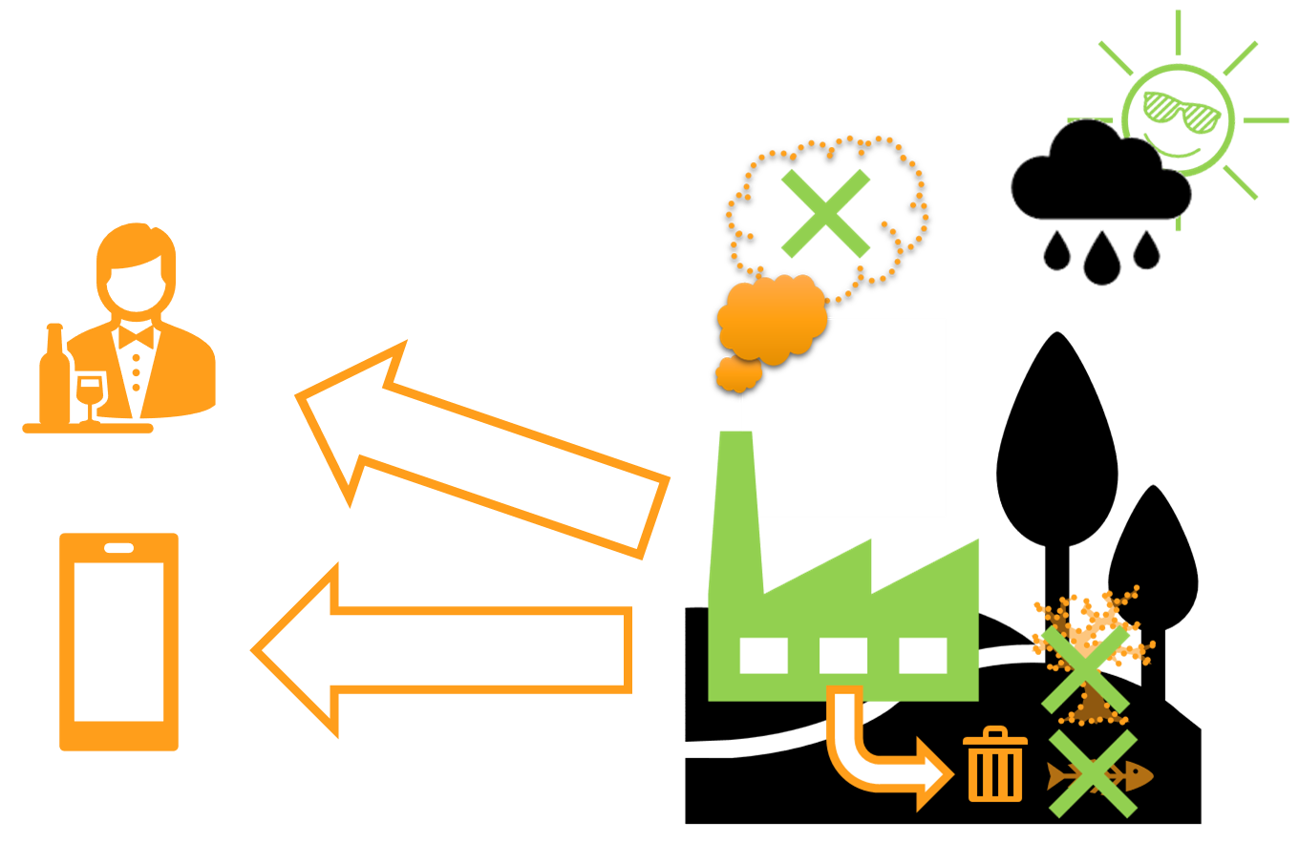









Where Did we Stop Last Time?
Company XY

Slide 5
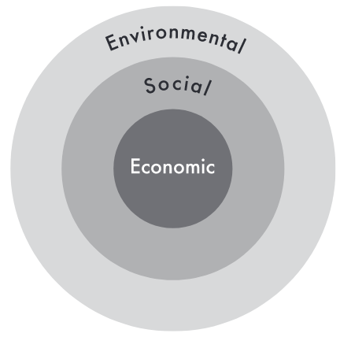
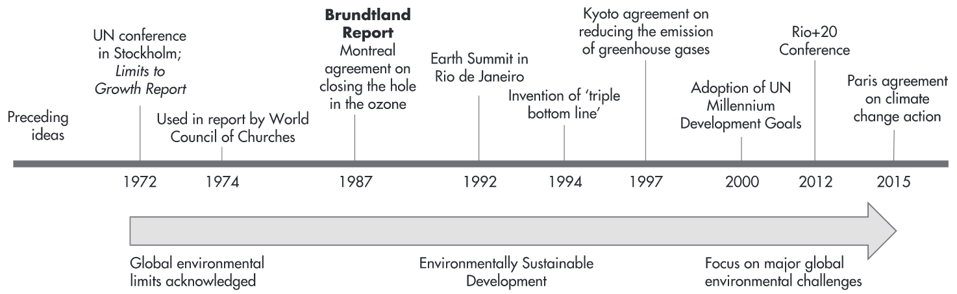
The new Kid on the Block?
Environmental management tools
Standardised ESG reporting
Notes:
1972: Erste UN-Umweltkonferenz (Stockholm)
1972 Limits of Growth
1977 in Hameln: HH Atomkraftgegner
Jahreswechsel 1983 zu 1984: Besetzung Stopfenreuther Au bei Hainburg

Slide 6


Are we Missing Something?
Company XY

Slide 7
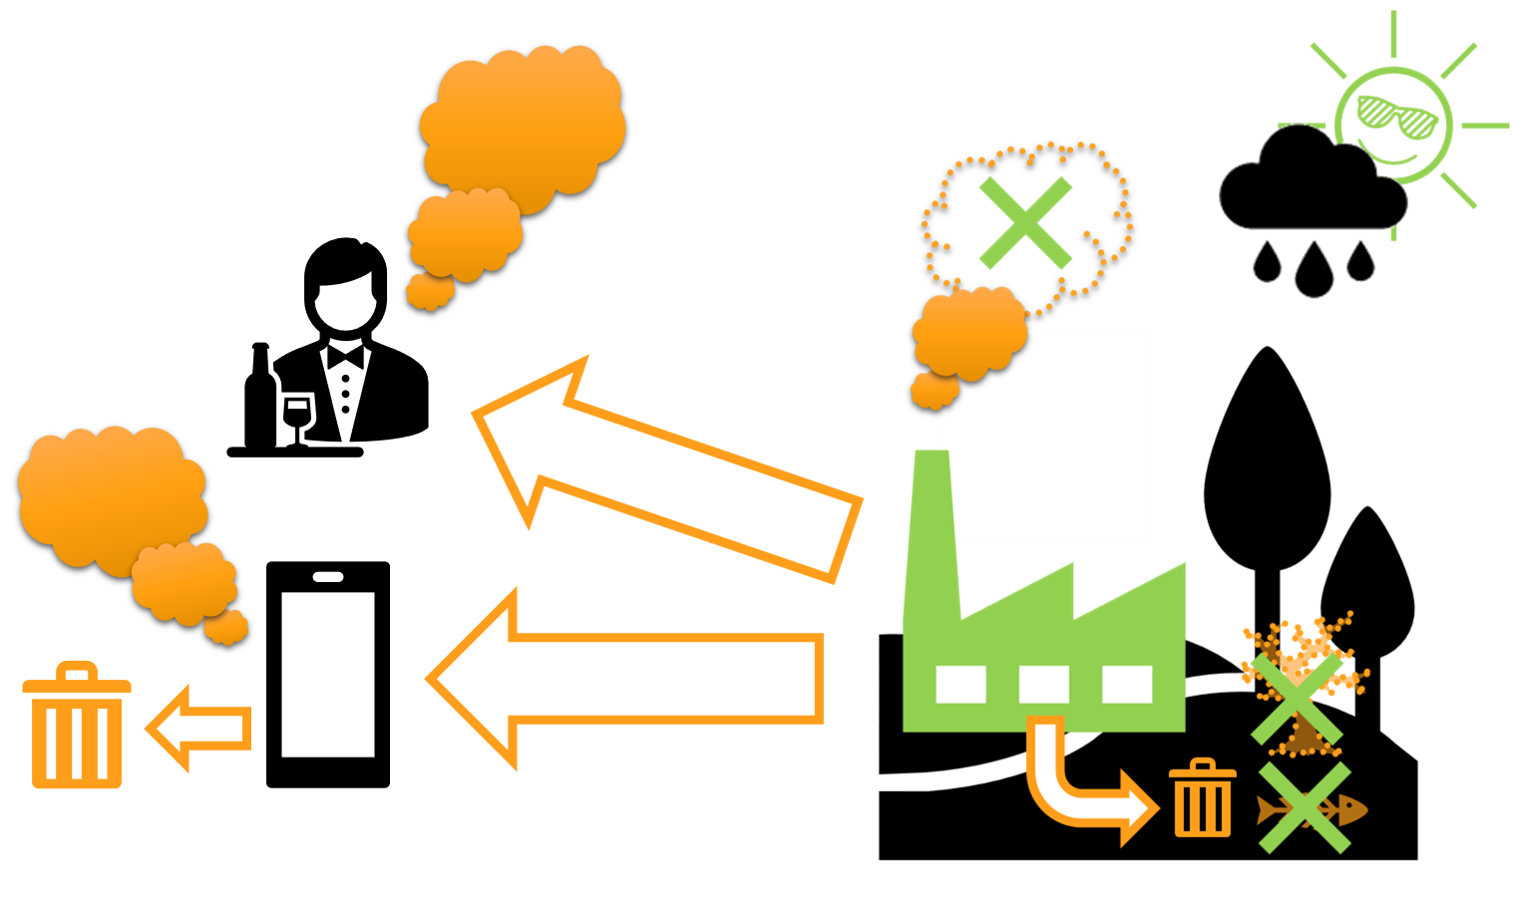



Are we Missing Something?
Company XY

Slide 8
Are we Missing Something?
Company XY

Slide 9
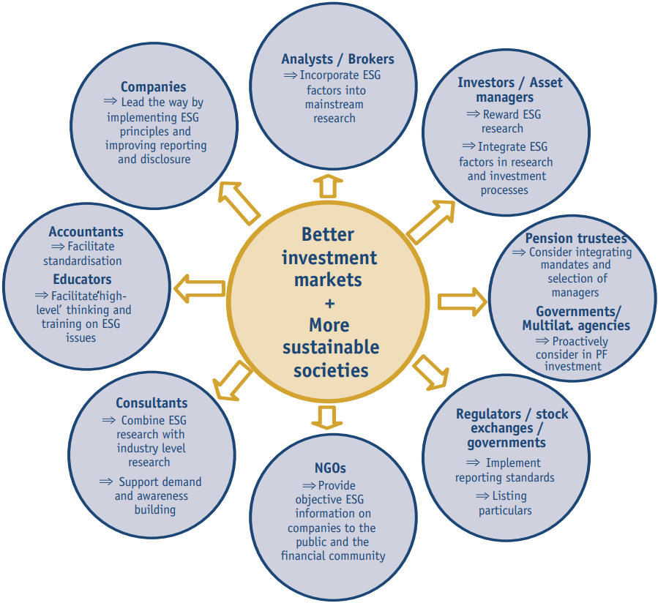
An ESG-Driven Perspective on Performance
“Companies are asked to take a leadership role by implementing environmental, social and corporate governance principles and polices and to provide information and reports on related performance in a more consistent and standardised format.” (UN Global Compact, 2004: II)
Stronger and more resilient financial markets
Contribution to sustainable development
Awareness and mutual understanding of involved stakeholders
Improved trust in financial institutions

Slide 10
Overall Goal of ESG-driven Perspectives
Improved transparency & trust with stakeholders
e.g. investors, customers, regulators
Enhanced risk management, especially regarding environmental and social risks
Better access to capital 👉 more investors increasingly consider ESG criteria
Benchmarking and comparability
Stronger brand reputation
Regulatory readiness 👉 mandatory ESG disclosure
Improved internal performance tracking on sustainability goals and non-financial KPIs
Attraction and retention of talent, particularly among employees who value corporate responsibility
Greater innovation 👉 sustainable product & process development

Slide 11
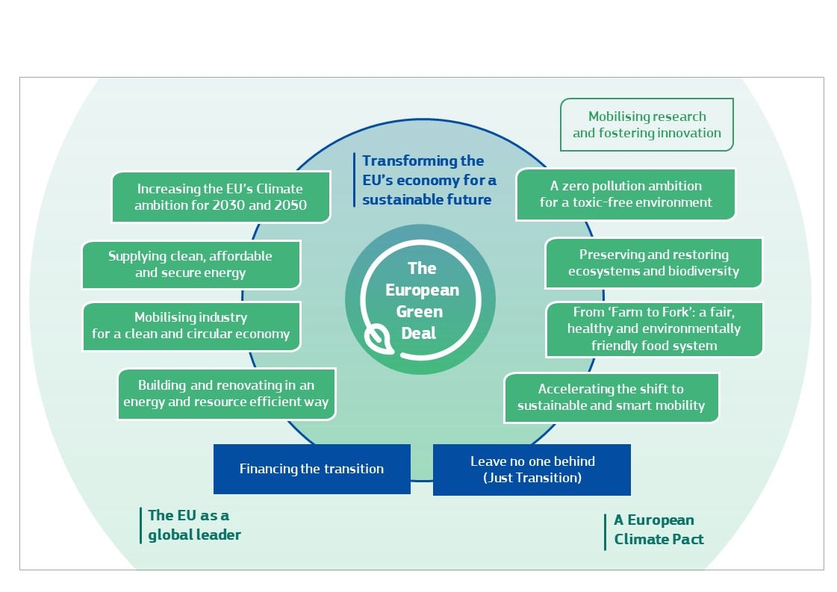
The Integration of ESG-Driven Perspectives: The EU Green Deal & its Consequences
Overall goal in 2019: first climate-neutral continent:
no net emissions of greenhouse gases by 2050
economic growth decoupled from resource use
no person and no place left behind

Slide 12

What’s Next?
 | Focus on …
 | Substance |  | Procedure
Voluntary
Mandatory
✅
Carbon Neutral
✅
Cradle to Cradle
Further CSR activities
✅
✅
✅
Life Cycle Assessment
Eco-Labels
B-Corp
ESG reporting: GRI, SASB, ISSB etc.
Climate-focused reporting: TCFD & CDP
Social-focused standards: SA8000
Sector-specific standards: OECD Due Diligence Minerals
XY
Environmental Management
Sustainability Management
EU CSRD
ISO 14001 EMAS
✅
CE Marking
XY
EU Industrial Emissions Directive (IED)
EU Corporate Sustainability Due Diligence Directive (CSDDD)
✅
EU Emissions Trading System (ETS)
EU Green Claims Directive
Env. Impact Assessment (EIA)
Nat. regulations on air, waste, water & soil
✅
✅

Slide 13
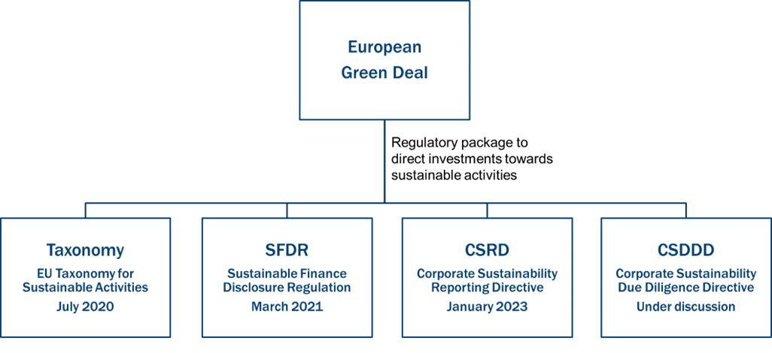
The Eu Green Deal & its Consequences

Slide 14
The Eu Green Deal & its Consequences

Slide 15

So …
👉 give me more tools!

Slide 16
The EU Taxonomy

Slide 17
The EU Taxonomy …
🤔

Slide 18
The EU Taxonomy …
Introduced 2020: EU Taxonomy Regulation (Regulation (EU) 2020/852)
Part of the EU Sustainable Finance Action Plan
Mail Goal: Redirect capital towards sustainable economic activities
Create a common language and definition what is considered “sustainable”
6 environmental objectives
Combat “greenwashing”
Company XY

Slide 19
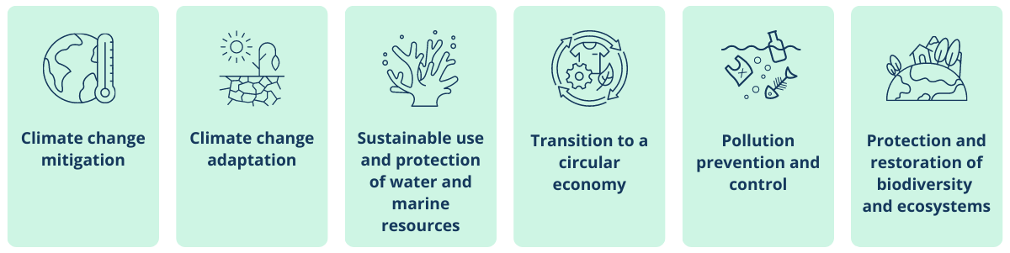
Environmental Objectives

Slide 20
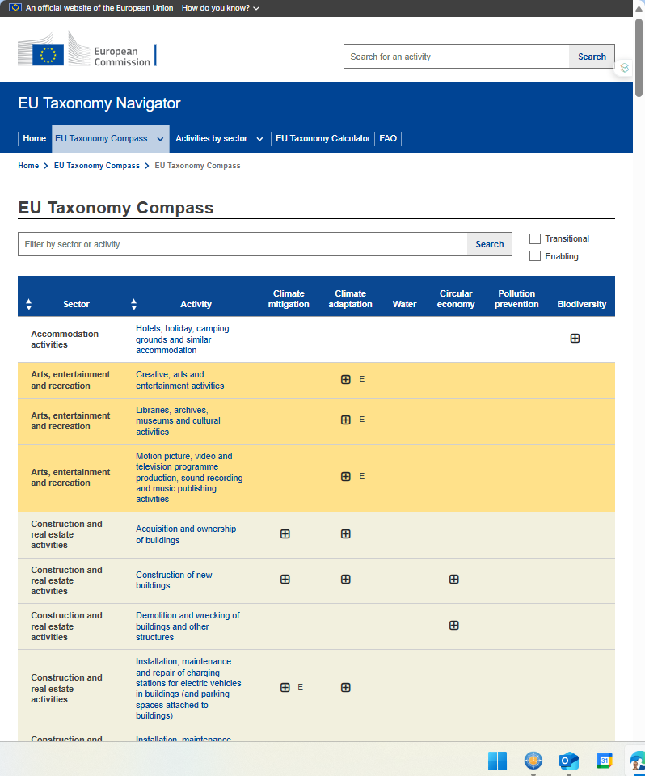
Environmental Objectives
How to assign activities to these objectives?
👉 EU Taxonomy Compass

Slide 21
Environmental Objectives
How to assign activities to these objectives?
👉 EU Taxonomy Compass
What kind of “activities” have to be reported:
Annual turnover
CapEx (Capital Expenditure):
Long-term investments
OpEx (Operating Expenditure)
Day-to-day expenses

Slide 22
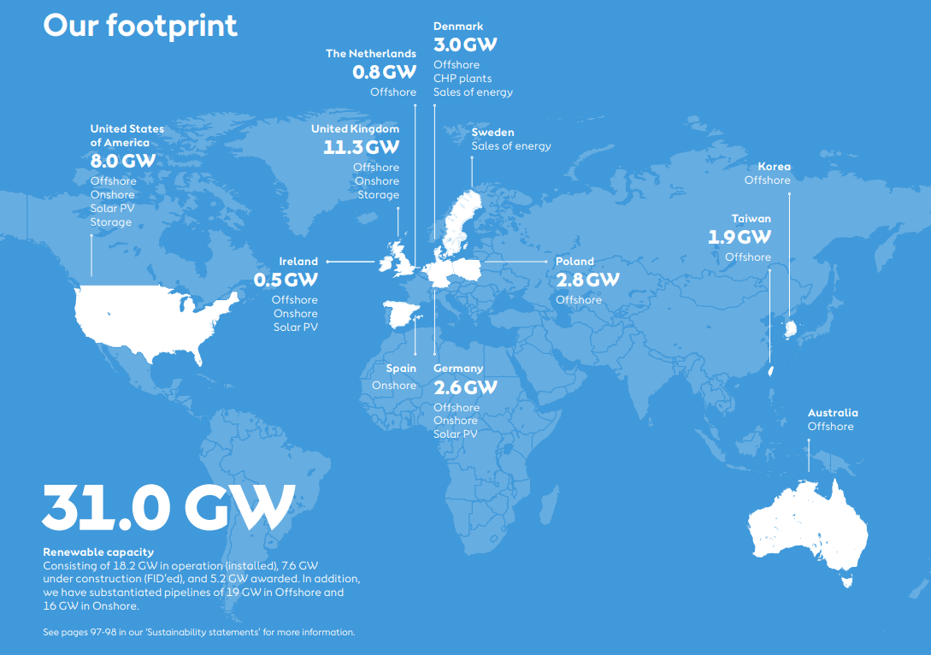
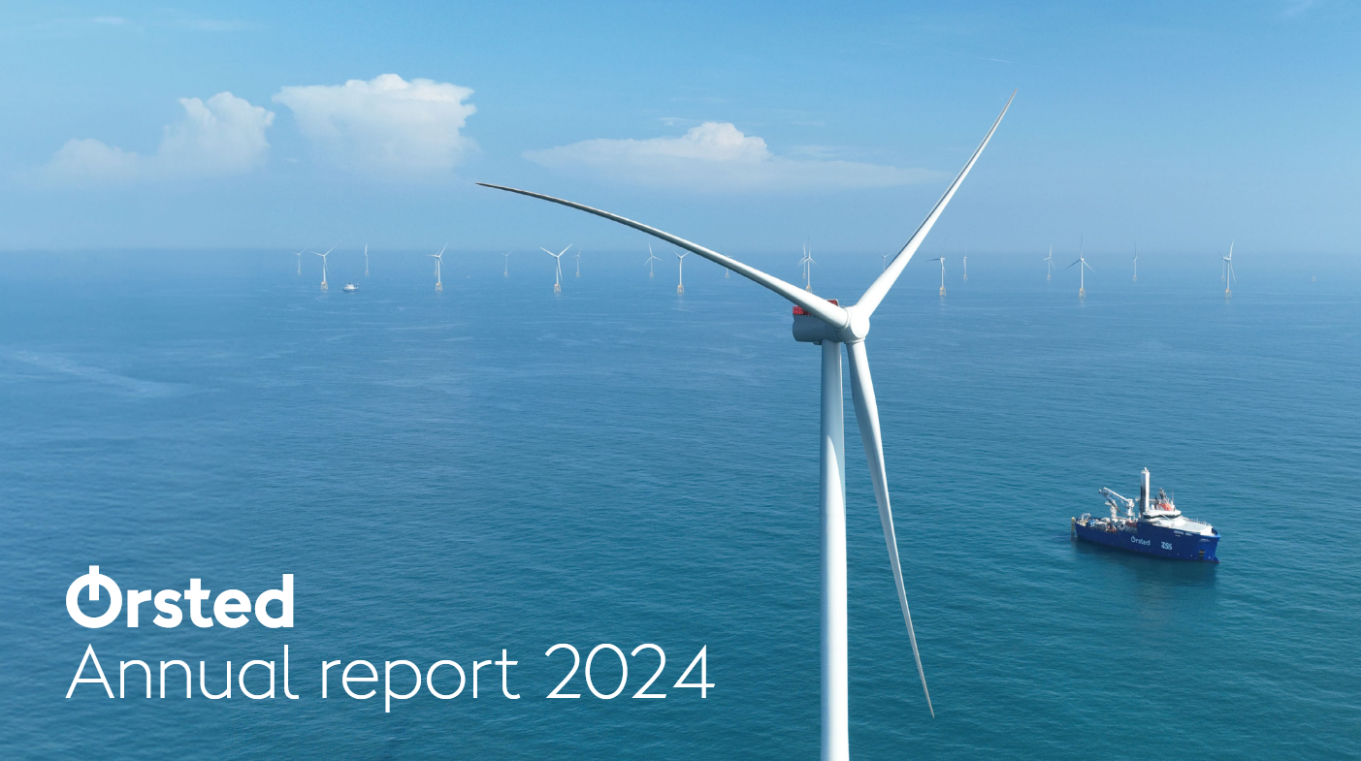
An Example: Orsted – Danish Energy Company

Slide 23
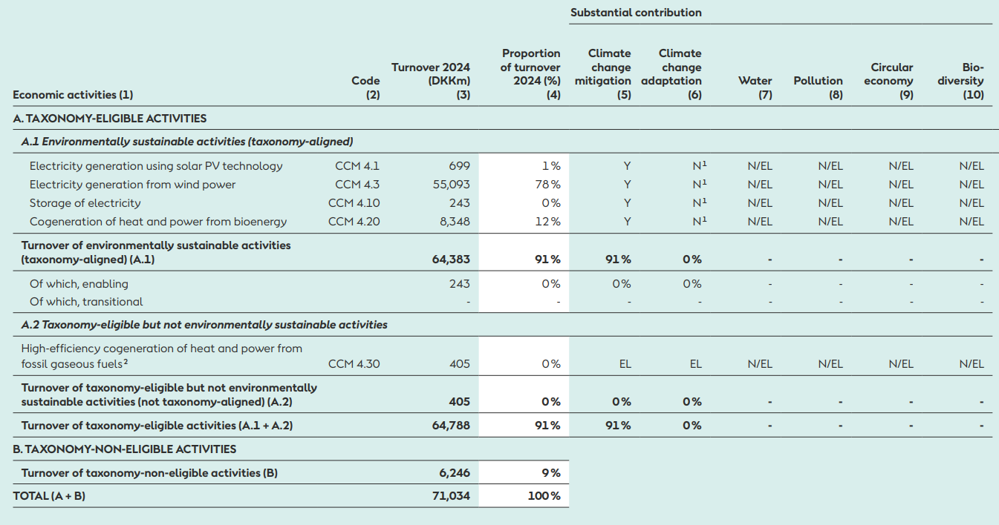
An Example: Orsted

Slide 24
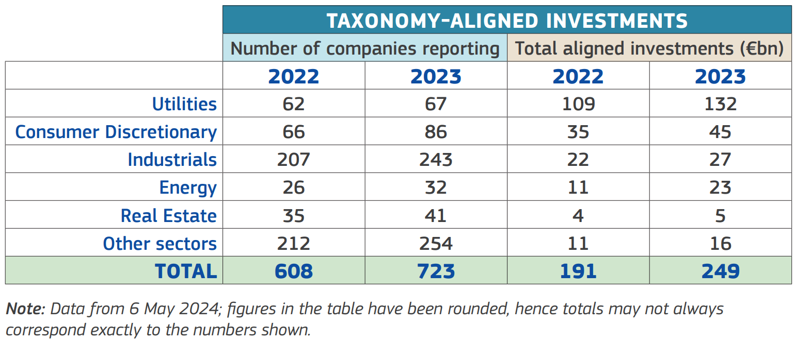
@ Redirecting Investments in Environmental Objectives

Slide 25
Are we Missing Something?
Company XY

Slide 26
Who has to Declare All This

Slide 27
The EU Corporate Sustainability Reporting Directive (CSRD)

Slide 28
The EU Corporate Sustain … What?
🤔

Slide 29
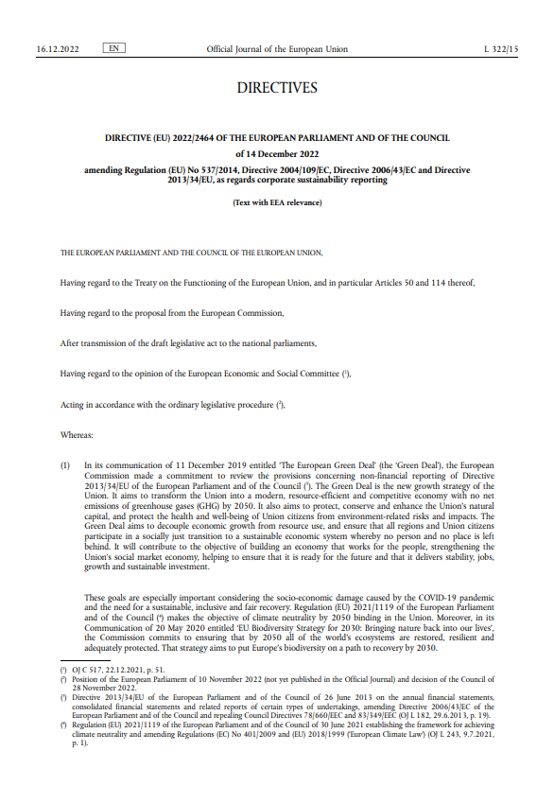
Corporate Sustainability Reporting Directive
EU directive (2022) = has to be implemented nationally
AUT: Nachhaltigkeitsberichtsgesetz (NaBeG)
Main goals:
Improve the quality, consistency & comparability of sustainability reporting in EU
Standadised ESG information
Extend reporting obligations to more companies
Foster integration EU Green Deal & Sustainable Finance Agenda

Slide 30
@ Integration:
CSRD Who, when, how, etc.?
Taxonomy
Classification of sustainable activities
Level: individual activity
ESRS Reporting standard Level: Company
Directive (EU) 2022/2464
Report
Standards by EFRAG
Regulation (EU) 2020/852

Slide 31

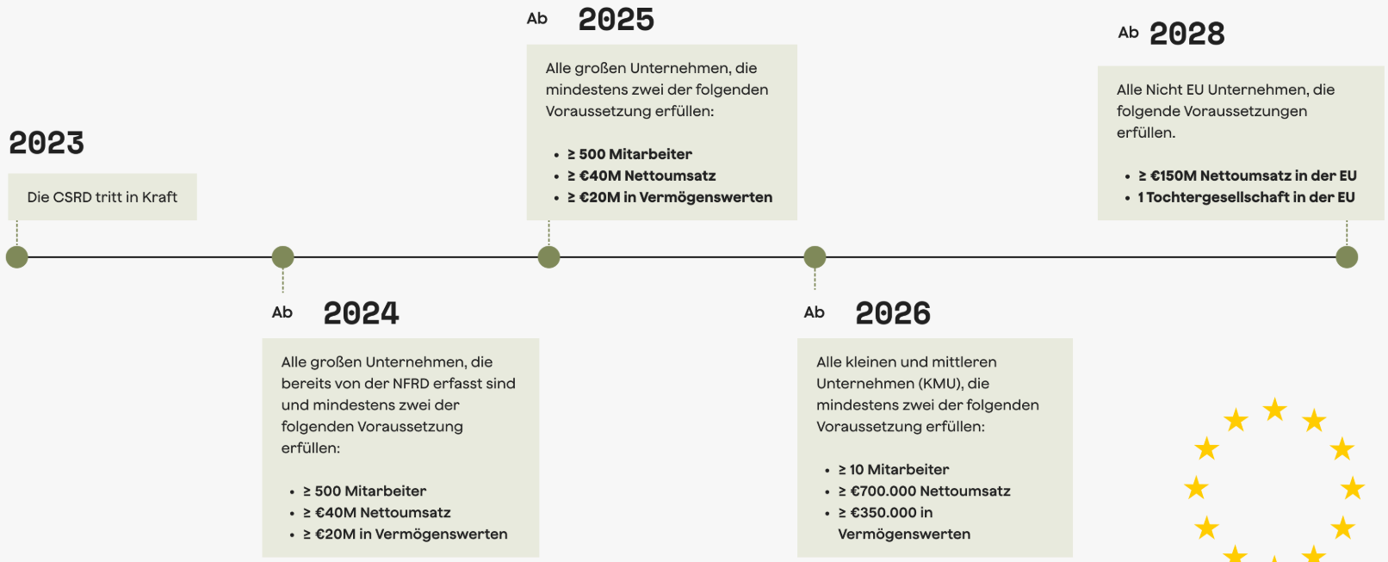




CSRD: Who must Report? (Flashback Version)
2026*
2029
≥ 250 Mitarbeitende
≥ €50M Nettoumsatz
≥ €25M Vermögenswerte
2025
2028*

Slide 32
CSRD: Who must Report? Post-Omnibus Version
Category | Criteria | Employee Threshold | Financial Threshold | Listing Status | First Report Due | Financial Year Covered
Wave 1: Existing NFRD Companies | Companies previously subject to NFRD (public-interest entities) | >500 | Not specified | Listed / Banks / Insurers | 2025 | 2024
Wave 2: Large Companies (revised) | Large companies (including unlisted) | >1,000 | €50 million turnover or €25 million balance sheet total | Listed or unlisted | 2028 | 2027
Wave 3: Listed SMEs | SMEs listed on EU regulated markets (excluding micro-enterprises) | No minimum | Not specified | Listed on EU regulated market | 2029 | 2028
Wave 4: Non-EU Companies | Non-EU companies with significant operations in the EU | N/A | €150 million EU turnover AND EU branch/ subsidiary in scope | Non-EU | 2029 | 2028
Voluntary Reporting (VSME) | Non-listed SMEs not covered by CSRD | Voluntary | Voluntary | Not listed | Optional | N/A

Slide 33
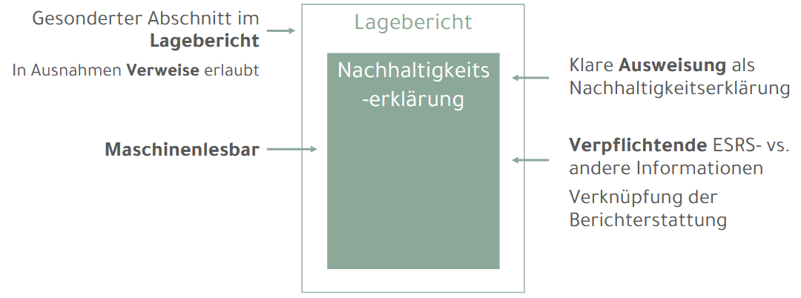
How to Deliver the Sustainability Report
Main idea: Enrich existing financial reporting instruments
From financial 👉 to ESG-driven perspective
In AUT:
CSRD obligation: Lagebericht
lt. Unternehmensgesetzbuch – UGB
has to pass the statutory audit
No obligation: Own report
Company Type | Lagebericht Required? | Size Criteria (must meet 2 of 3)
AG (Aktiengesellschaft) | ✅ Yes (always) | Not relevant – mandatory regardless of size
Large GmbH | ✅ Yes | > €5 million balance sheet total> €10 million turnover> 50 employees
Medium GmbH | ✅ Yes | Same as above
Small GmbH | ❌ No | ≤ €5m balance sheetAND ≤ €10m turnoverAND ≤ 50 employees
OG / KG | ❌ No (unless structured as Kapitalgesellschaft & Co) | Same as GmbH if classified as large/medium capital company
GmbH & Co KG (if large/medium) | ✅ Yes | Same as GmbH size criteria
Foreign branches (Zweigniederlassungen) | ❌ No | Reporting obligations handled in home country

Slide 34
How to Deliver the Sustainability Report
Who has to issue a “Lagebericht” in AUT:
Company Type | Lagebericht Required? | Size Criteria (must meet 2 of 3)
AG (Aktiengesellschaft) | ✅ Yes (always) | Not relevant – mandatory regardless of size
Large GmbH | ✅ Yes | > €5 million balance sheet total> €10 million turnover > 50 employees
Medium GmbH | ✅ Yes | Same as above
Small GmbH | ❌ No | ≤ €5m balance sheetAND ≤ €10m turnoverAND ≤ 50 employees
OG / KG | ❌ No (unless structured as Kapitalgesellschaft & Co) | Same as GmbH if classified as large/medium capital company
GmbH & Co KG (if large/medium) | ✅ Yes | Same as GmbH size criteria
Foreign branches (Zweigniederlassungen) | ❌ No | Reporting obligations handled in home country

Slide 35
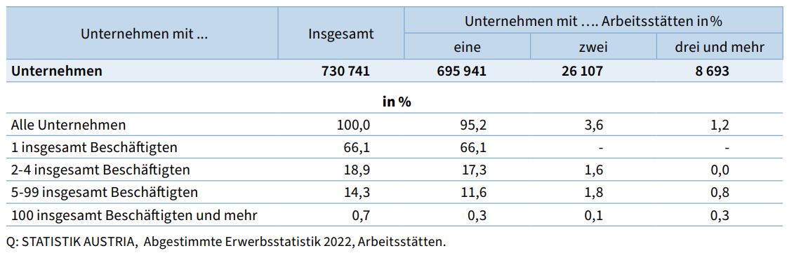
Digression: “Large” Business in AUT
Enterprise Category | Number of Companies | Number of Employees | Share of Total Employment
SMEs | ~579,500 | ~2.5 million | 66%
Large Enterprises | ~1,800 | ~1.3 million | 34%

Slide 36
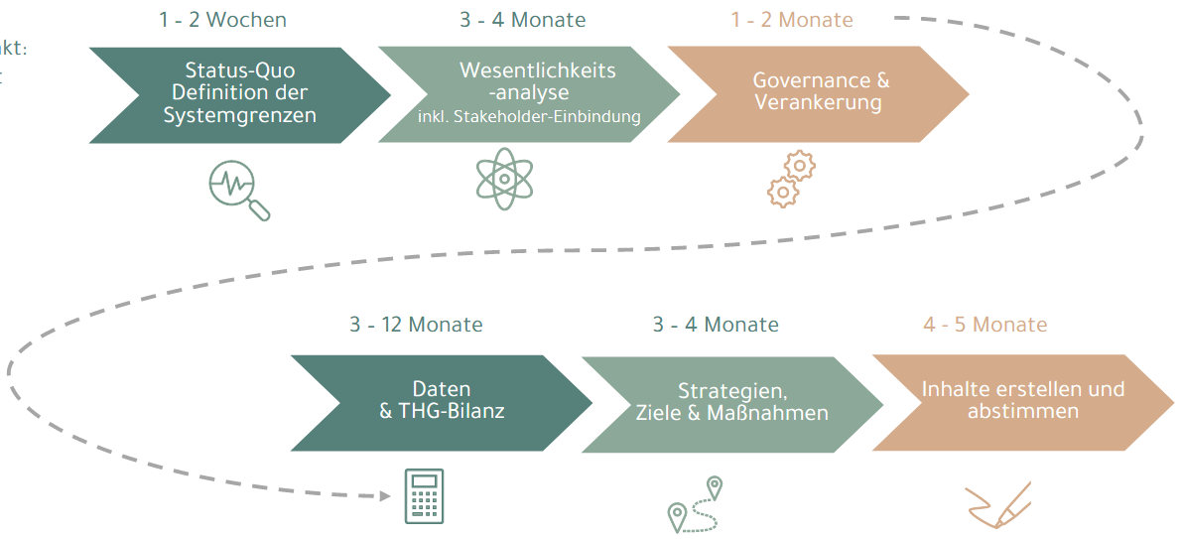

A Workflow for Delivering a Sustainability Report

Slide 37
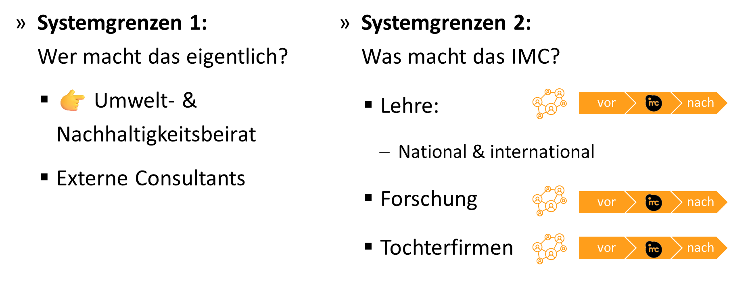
Status Quo & System Boundaries
👉 Try to understand life-cycles of your products & services (= value chains)

Slide 38
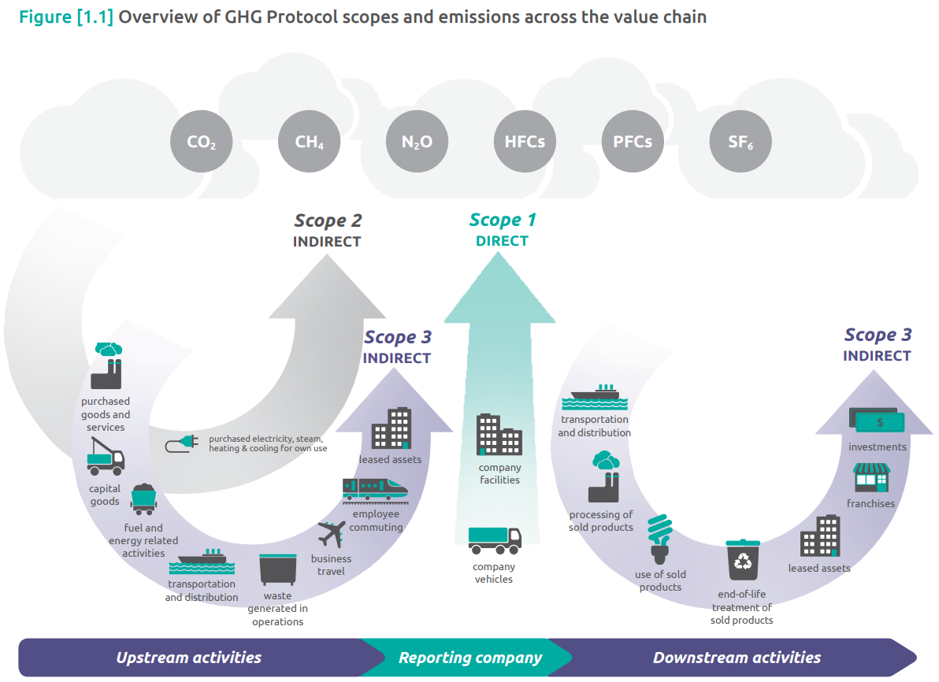
@ Value Chain

Slide 39
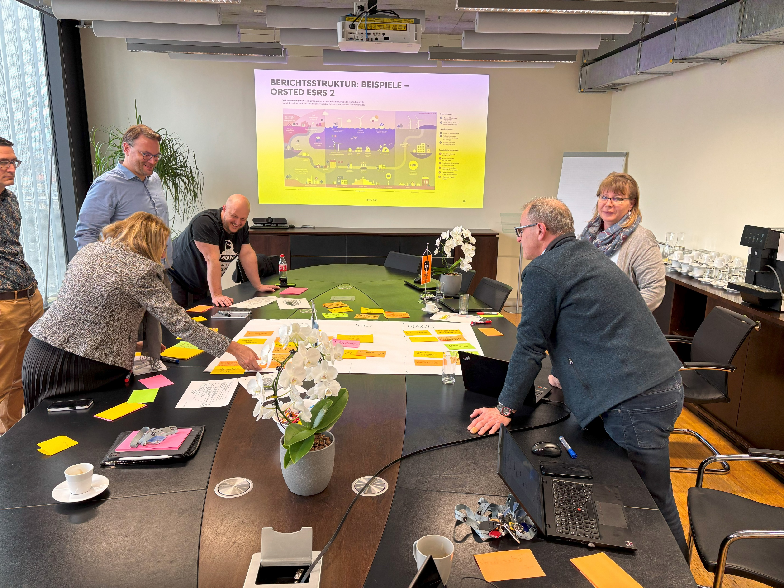
Status Quo & System Boundaries
👉 Try to understand life-cycles of your products & services (= value chains)

Slide 40
An Example: Orsted – Danish Energy Company

Slide 41
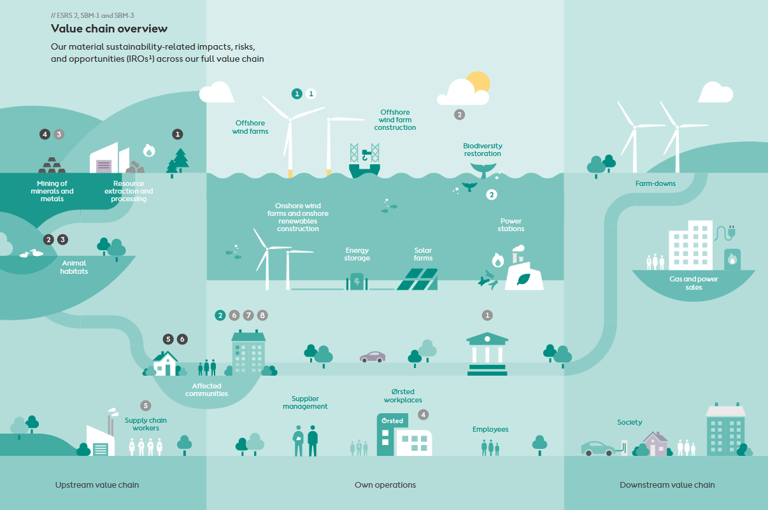
An Example: Orsted’s Value Chain

Slide 42
A Workflow for Delivering a Sustainability Report

Slide 43

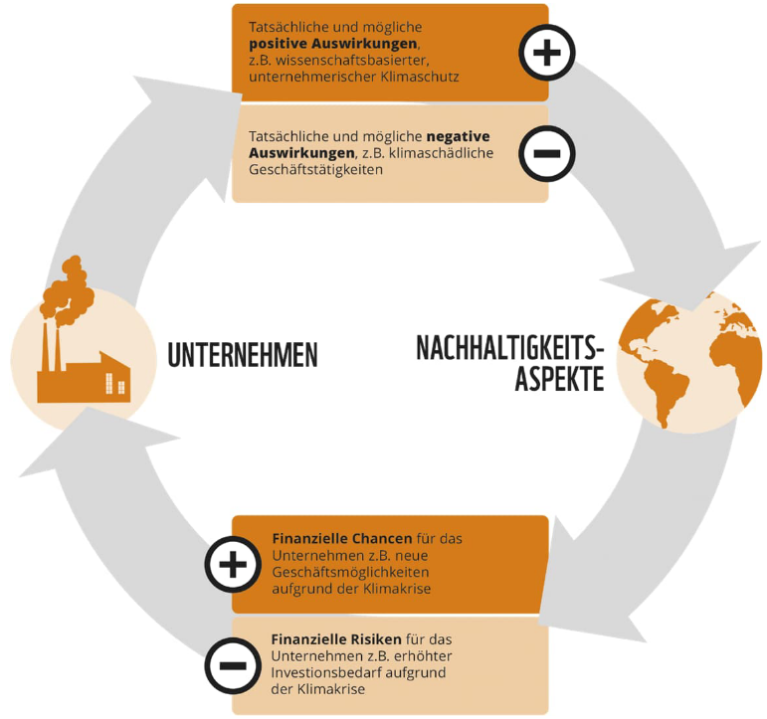
Materiality Assessment
Core reporting concept 👉 only “material” impacts, risk & opportunities (IRO) have to be reported
Financial materiality: How sustainability issues affect company value
Impact materiality: How company activities affect people and environment

Slide 44
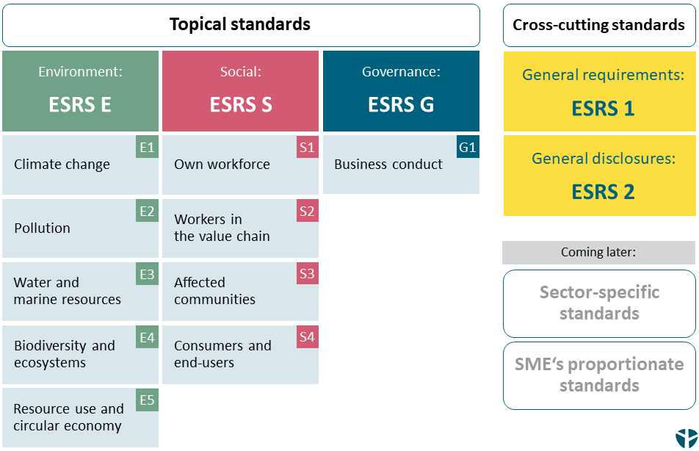
Materiality Assessment
Break down value chain in processes
European Sustainability Reporting Standards (ESRS):
Interaction value chain processes & standards

Slide 45
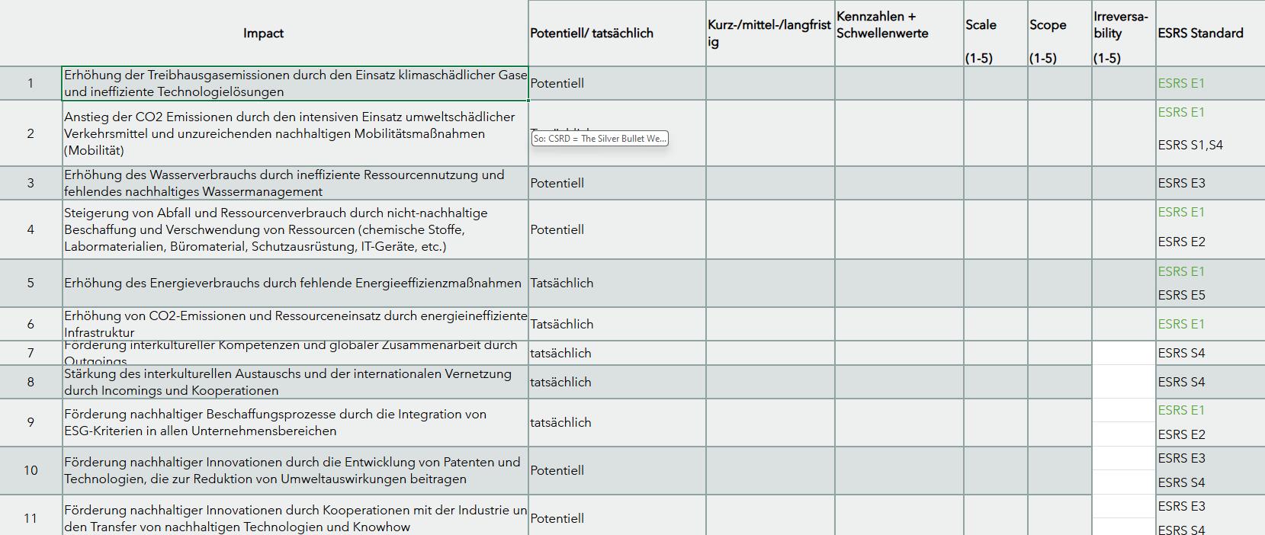
Materiality Assessment: The IMC Experience

Slide 46
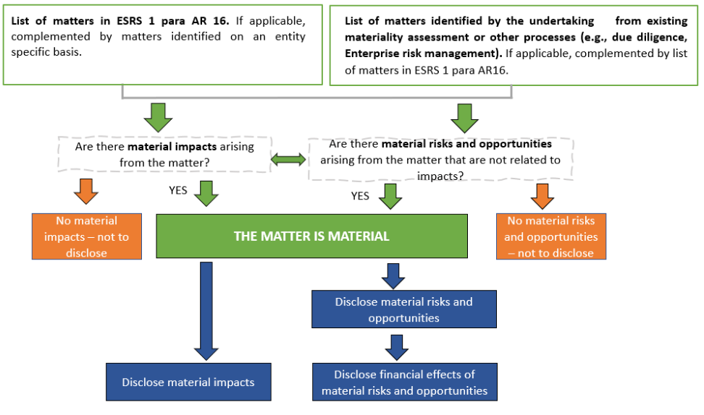
Why Material Assessment At All?

Slide 47
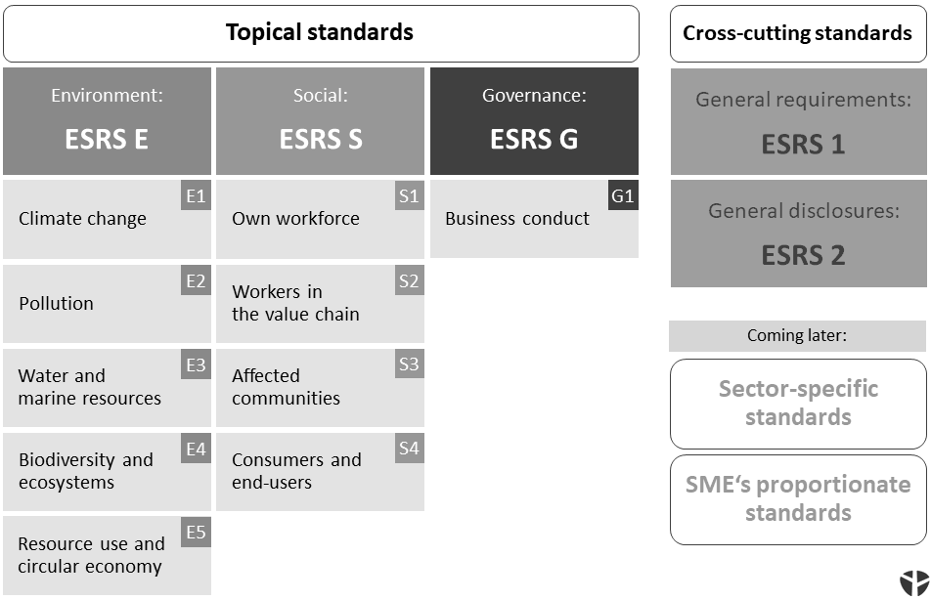
Why Material Assessment At All?
If IROs in a standard = material
KPI to measure them
EFRAG ESRS Data Points
Mandatory / optional
✅
✅
✅

Slide 48
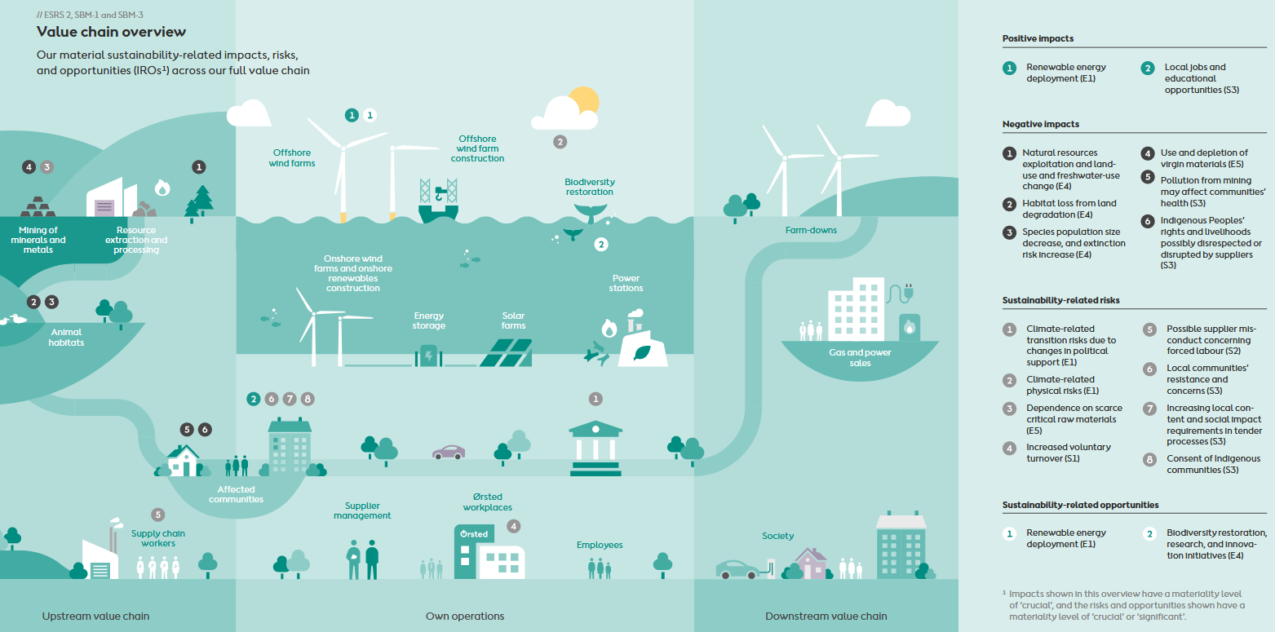
An Example: Orsted’s Value Chain

Slide 49
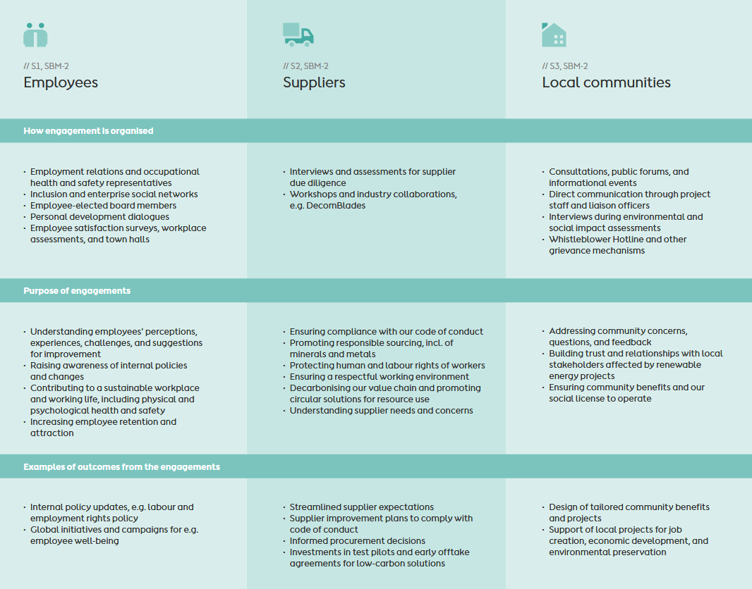
Why Material Assessment At All?
If IROs in a standard = material
KPI to measure them
EFRAG ESRS Data Points
Mandatory / optional
Engage stakeholders in overall materiality assessment
Qualitative disclosure of engagement

Slide 50
A Workflow for Delivering a Sustainability Report

Slide 51
Bases on Materiality: Standard-specific Disclosure
For each material standard: Disclosure of “relevant” information
Element | What It Covers
1. Governance | How the company’s governance bodies (e.g. board, committees) oversee and are involved in the topic
2. Strategy | How the topic is integrated into the company’s business model, strategy, and overall objectives
3. Impact, Risk & Opportunity Management | How the company identifies, assesses, and manages impacts, risks, and opportunities related to the topic
4. Metrics and Targets | Quantitative and qualitative indicators used to monitor performance, and the targets set to guide improvements

Slide 52
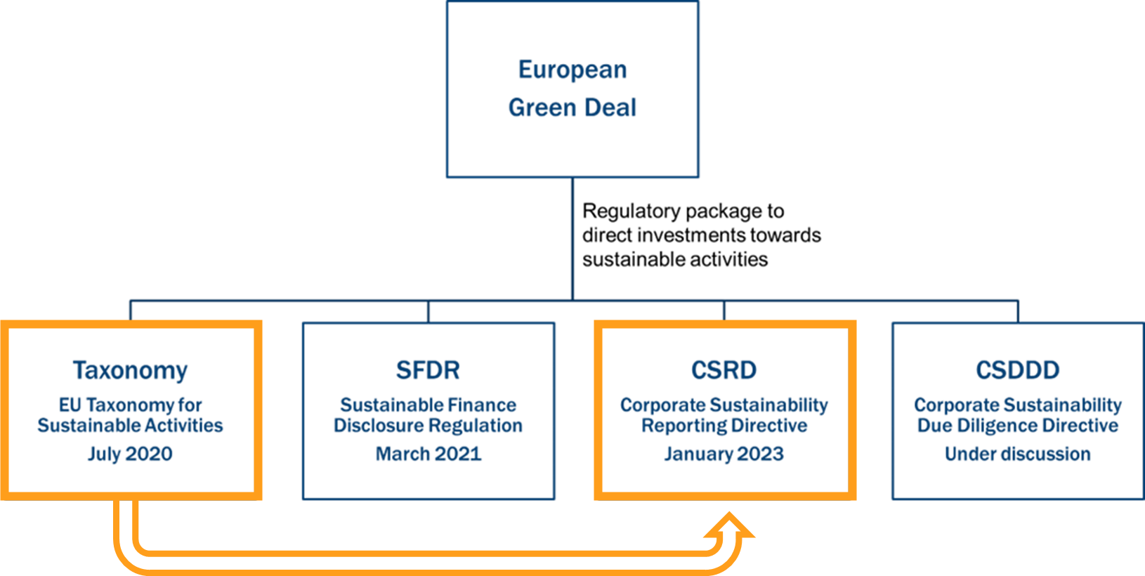
Standard-specific Disclosure: The Special Case of the Taxonomy Information
ESRS E1 – Climate Change: 👉 mandatory
% of taxonomy-eligible & taxonomy-aligned turnover
% of CapEx and OpEx
Narrative Explanation:
methodologies, data sources & limitations
description of activities assessed & classification choices

Slide 53
Some Experiences with EU CSRD
Implementation Challenges:
Double materiality assessments proving more complex than anticipated
Significant data collection system upgrades required
Underestimated cross-departmental coordination needs
Resource Constraints:
Significant skills gaps in impact materiality assessment
Bottlenecks with qualified external assurance providers
Increased demand for specialized sustainability consultants
Need for extensive staff training on new requirements
Market Developments:
Emergence of specialized CSRD reporting software solutions
Companies with strong pre-CSRD ESG practices showing smoother transitions
Investors already incorporating CSRD disclosures into decision-making (?)
Regulatory Environment:
AUT: Still waiting for NaBeG
Emergence of sector-specific standards
Evolving guidance from regulators as implementation progresses

Slide 54
So: CSRD = The Silver Bullet We have been Looking For?
Framework | Primary Focus | Approx. Reporting Companies | Key Strengths | Target Audience | Recent Developments
CSRD - Corporate Sustainability Reporting Directive | EU comprehensive sustainability reporting | ~50,000 (projected) | Regulatory backing with assurance requirements | EU companies & those with EU operations | Phased implementation starting 2024
UN Global Compact | Alignment with 10 principles (human rights, labor, environment, anti-corruption) | 15,000+ | Straightforward framework for beginners | Organizations of all sizes | Enhanced reporting framework (2023)
CDP - Carbon Disclosure Project | Environmental impact (climate, water, forests) | 13,000+ | Detailed metrics with comparative scoring | Companies responding to stakeholder requests | Aligning with TCFD, developing biodiversity disclosures
GRI - Global Reporting Initiative | Comprehensive ESG reporting | 10,000+ | Detailed metrics across wide range of issues | All organizations | Transitioned to enhanced GRI Standards (2021)
TCFD - Task Force on Climate-related Financial Disclosures | Climate risk disclosure | 3,000+ | Forward-looking scenario analysis | Companies with public debt/equity | Increasingly mandated by global regulators
SASB - Sustainability Accounting Standards Board | Industry-specific financial materiality | 2,500+ | Sector relevance and investor focus | Public companies | Now part of ISSB under IFRS Foundation
ISSB - International Sustainability Standards Board | Global baseline for sustainability financials | Emerging | Integration with financial reporting | Public companies | Released first standards (2023), implementation beginning 2024

Slide 55
Outlook

Slide 56
Wrap it up
Environmental Impact Assessment (EIA)
large-scale projects with significant environmental impacts 👉 precautionary principle
public participation, scoping, and multi-level licensing procedure
(Re-)Licensing Operational Facilities
Austrian Trade Regulation Act 👉 public interest: health, safety, environment, zoning
application, hearings, formal decision (“Bescheid”)
Waste Management & Waste Management Concept (WMC)
process descriptions, waste streams, logistics, and planning

Slide 57
Till next Session:

Slide 58
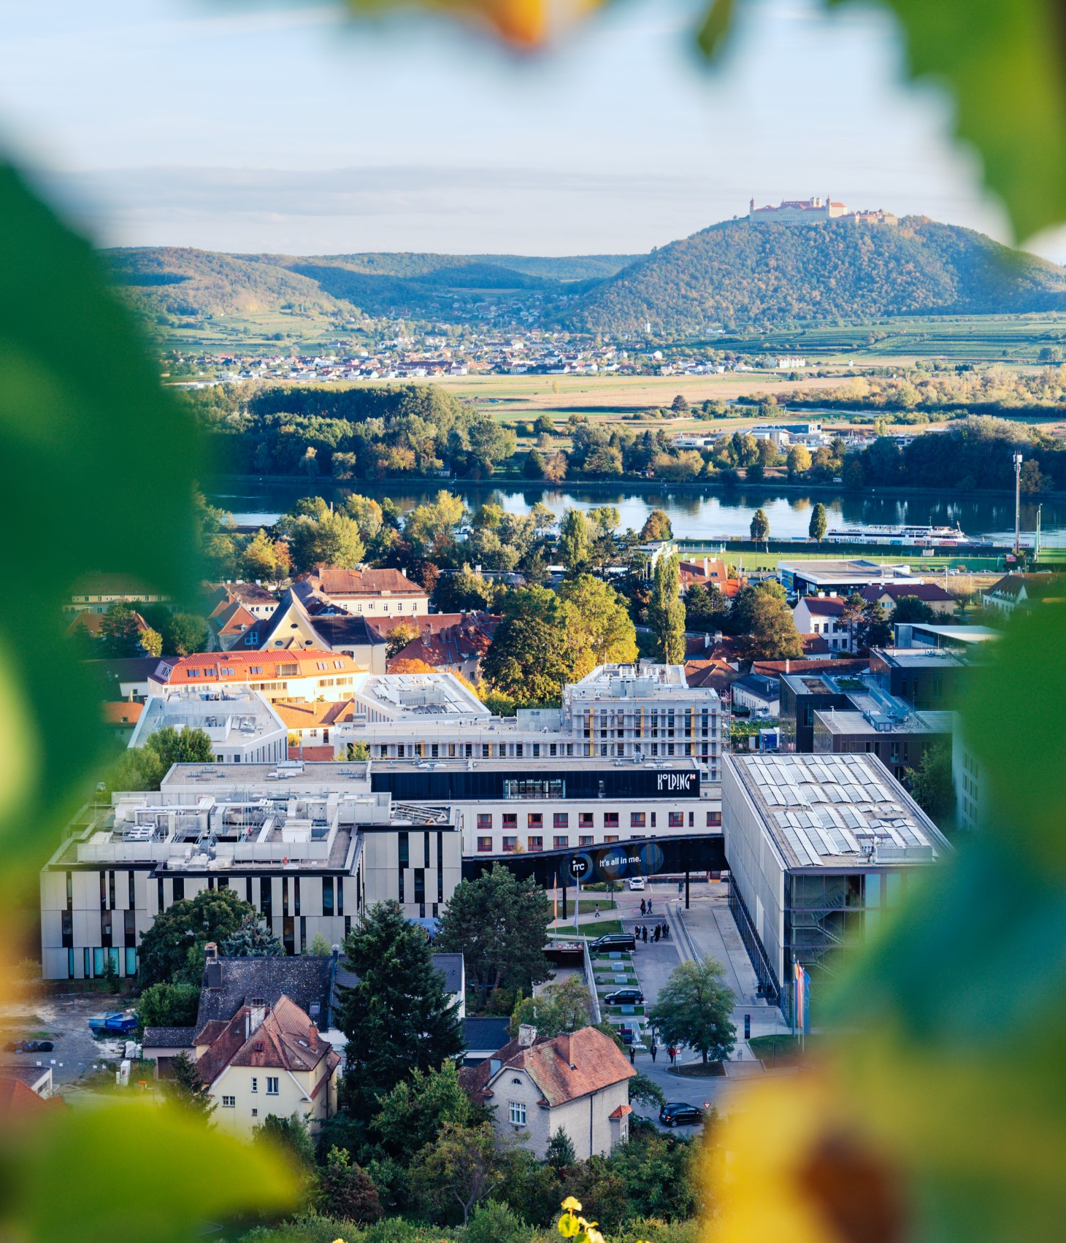

So long & cheerio!

